Slide 1
E-Pathshala:A presentation


epathshala.gov.in
epathshala.nic.in

Slide 2

Vision of Digital India Programme
Creation of ICT infrastructure in the country
eGovernance and on-Demand Services
Digital Literacy of citizens

Slide 3
e-Pathshala: An initiative of MHRD-GoI
Reaching the Diverse Clientele Groups is a Challenge
Imparting a Comparable Quality of Education is our motto
Expansion of ICTs have provided plenty of opportunities
Bridging the digital divide is our goal
NCERT has designed, launched e-Pathshala: a portal & apps for
showcasing & dissemination e-resources for its stakeholders:
    Students
    Teachers
    Educators
    Parents

Slide 4
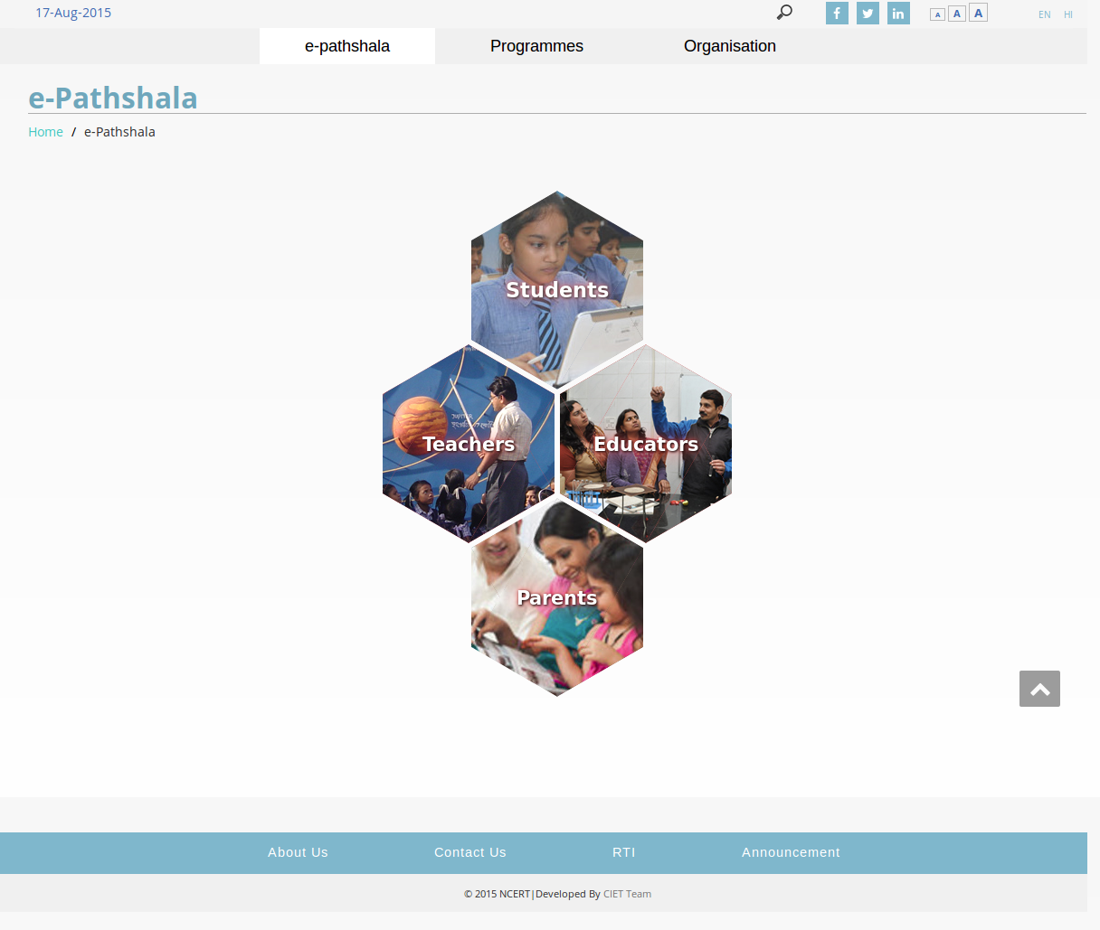

Slide 5
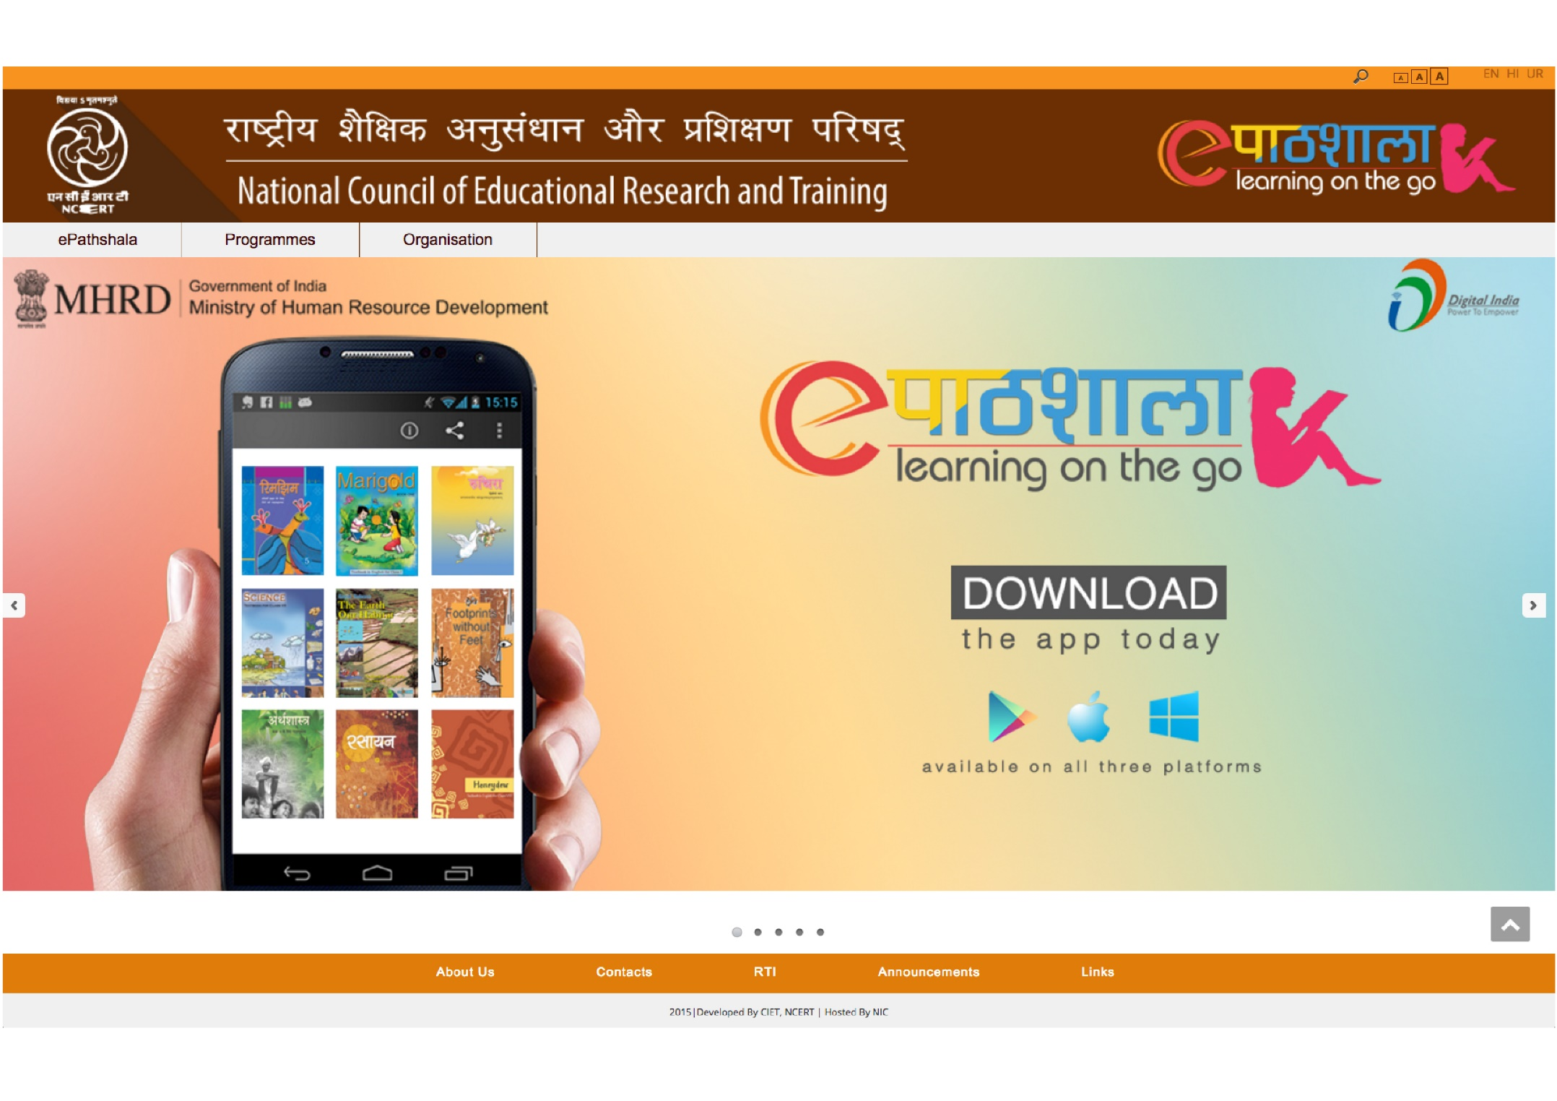


Slide 6
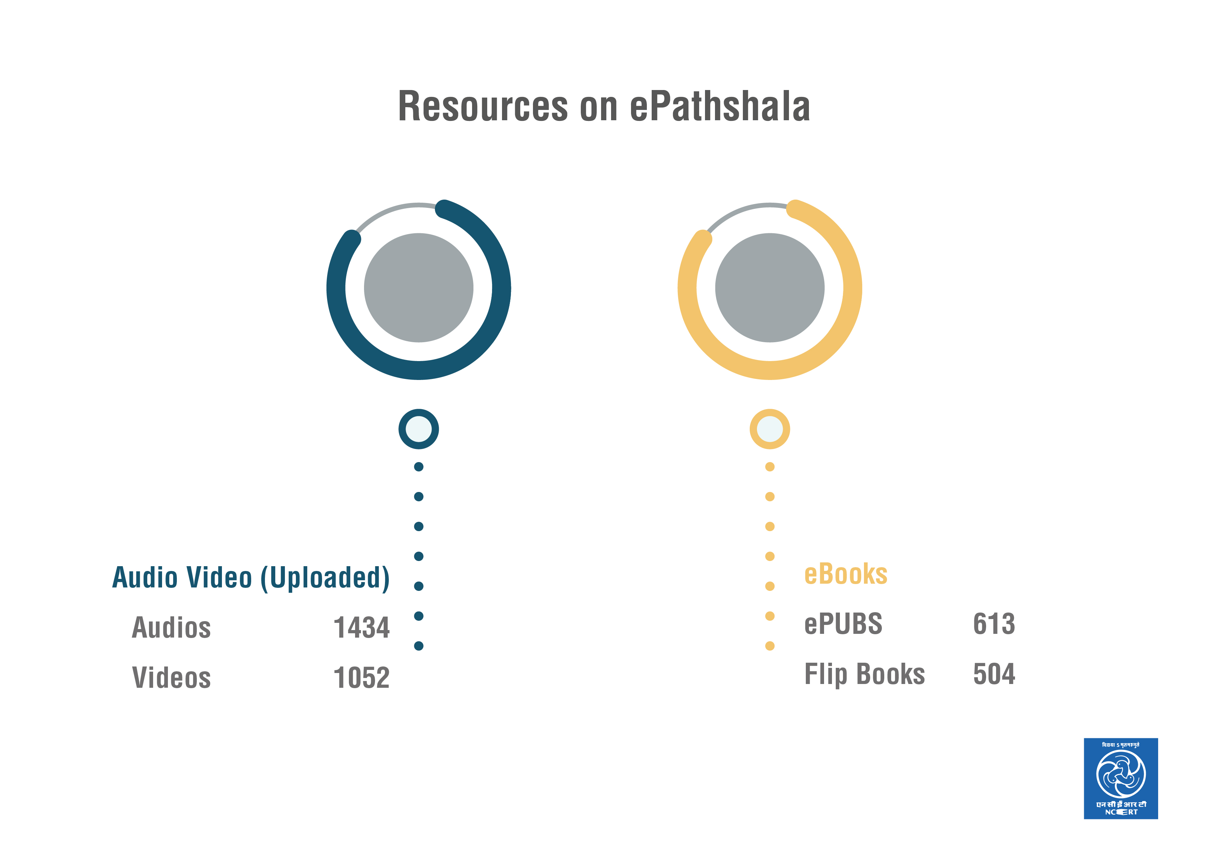


Slide 7
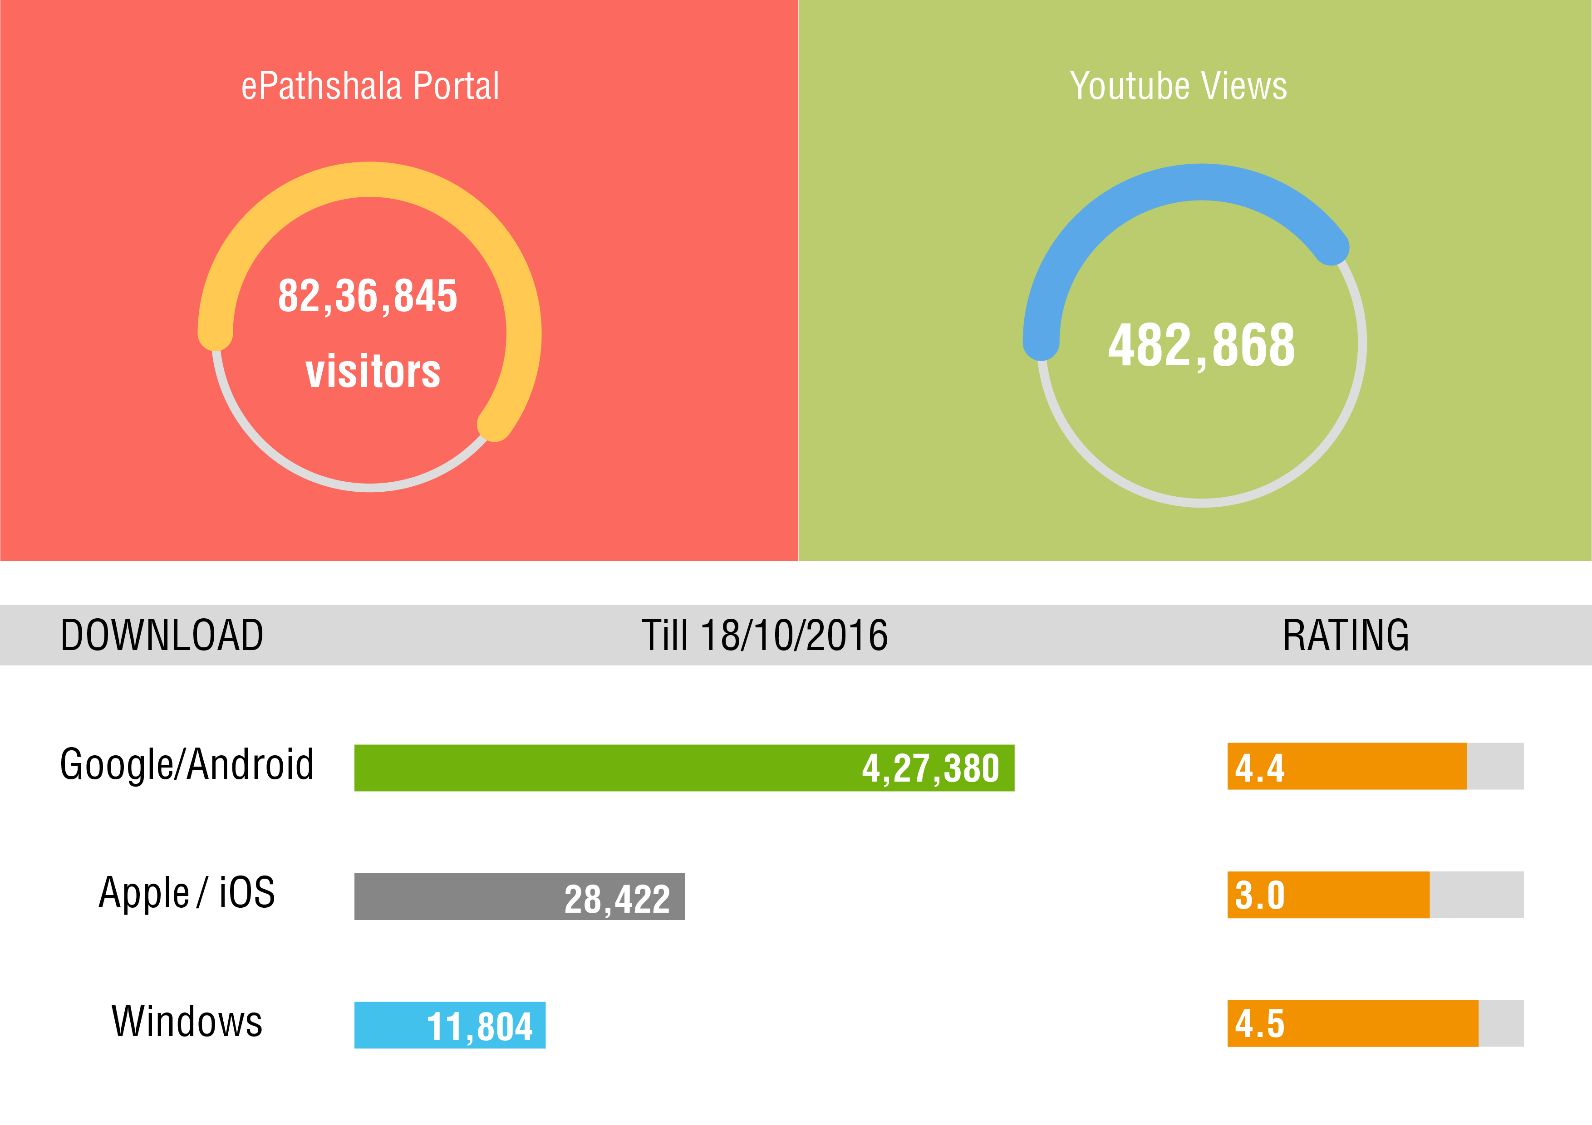

Slide 8
Action initiated to popularise ePathshala
Theme “ePathshala” included in all the training/workshops organised by NCERT (About 100 programmes in the country)
Advocacy done through print,non-print, social media etc.
Audio jingles created and disseminated
State Resource Groups created in 30 states covering 450 teachers, teacher educators from SCERTs, School Boards, DIETs, CTEs/IASEs, Schools.
Textbook digitisation training organised
Haryana digitised its textbooks, launched a mobile app as well
Textbook digitisation in other states in progress
Nominated for UNESCO Award, as best practices

Slide 9
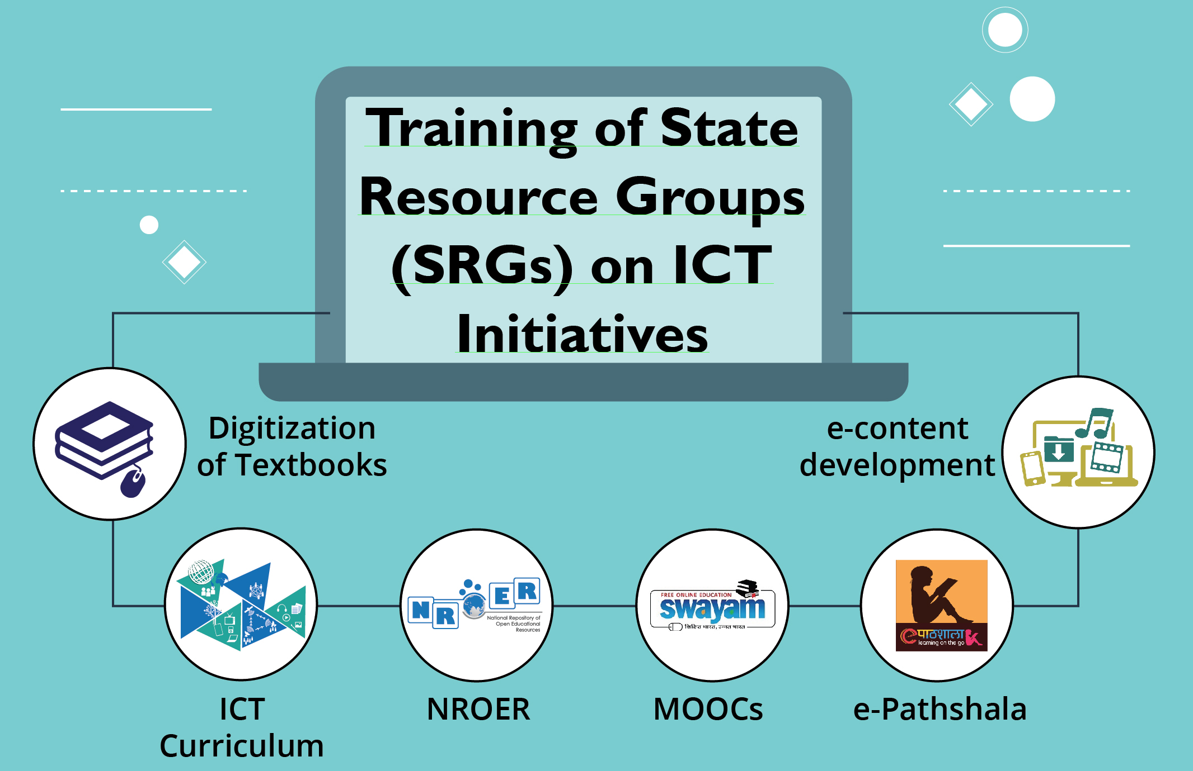

Slide 10
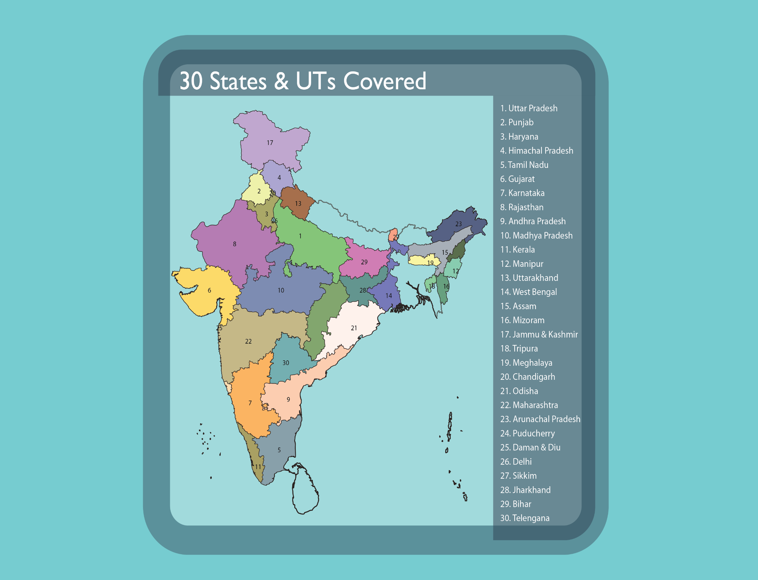

Slide 11
Future Plans:
Bringing all the 48 state boards/SCERTs etextbooks together
e-Resources in other Indian languages
Training resources and supplementary materials
Digitise & disseminate all materials of vocational education
Advocacy through multiple mode
Continuous updating of the portal and apps (Android, iOS, Windows)
Increase interactivity and make more user friendly

Slide 12

Thanks for your attention
For comments, suggestions, queries etc. Contact /mail to the
: jdciet.ncert@nic.in
epathshala.@nic.in
epathshala.@gov.in

